Slide 1


Datasets used to adapt the pre-trained ViT:
Testing Datasets:
FairFace (test-split)
RAF-DB (test-split)
VggFace2, ~170k samples (synthethic) age and gender labelled
UTKFace, ~24k samples age and gender labelled
Training Datasets:
FairFace, ~97k samples age and gender labelled
Lagenda, ~67k samples age and gender labelled
RAF-DB, ~17k samples emotion and gender labelled
CelebaHQ, ~17k samples gender labelled
. Low amount of celebrity data in training set
. Diverse ethinicities rappresented
. High annotator agreements for the labels
. Cross-dataset generalization with UTKFace and VggFace2
. Intra task-class imbalance for age and emotion
. Task imbalance, emotion heavily under-rapresented (5% of total)
. Missing labels, no samples is labelled for all tasks

Slide 2
Can we go deeper? Not really…
. Hardware limitations: our available hardware does not allow a full fine-tune of the model, even with mixed precision training and gradient checkpointing. It may be possible by a drastic reduction of the batch sizes, but then we incour on the problem of noisy gradients, accentued by the multi-task setting.
Do we want to go deeper? Yes but…
. Increase capacity + relatively small dataset: when we increase the model capacity by unfreezing more transformers block, if we do not also increase the size of the dataset we may likely encounter overfitting.
. Risk of catastrophic forgetting: updating the entire network risks catastrophic forgetting, where task-specific gradients could destroy the powerful, generalized knowledge acquired during the initial 5.4 billion pair pre-training.

Slide 3



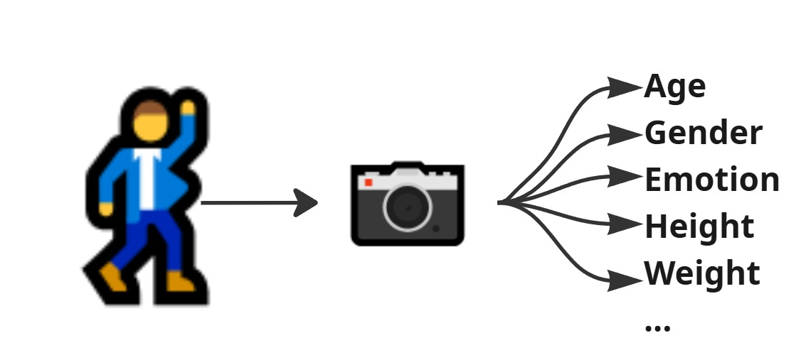
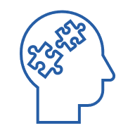
Soft Biometric Recogntion, What and Why?
Applications:
Social Robotics: a robot estimates a user is a child and automatically switches to a simpler speech and more playful voice
Marketing & Commerce: A digital sign detects a shopper's likely age and gender to show a targeted ad, like for a video game or a new perfume
Security & Access: A website uses facial age estimation to automatically block a user who appears underage from accessing mature content
Healthcare & Wellness: A wellness app monitors a user's vocal tone or facial expression through their phone to detect signs of stress or fatigue
Definition:
Soft biometrics are non-unique human attributes that can be indirectly collected from images. Unlike traditional biometrics such as fingerprints or iris patterns, soft biometric traits do not uniquely identify an individual but provide rich contextual information

Slide 4
Adapting Vision Language Models via parameter-efficient fine-tuning for Multitask Classification of Age, Gender, and Emotion
Relatori:
Prof. Mario Vento
Prof. Antonio Greco
Canditato: Antonio Sessa
Matricola: 0622702311

Slide 5
Index
01
02
Introduction
Methodology
03
Results

Slide 6
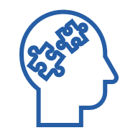
Soft Biometric Recogntion, what and why?
Definition
Applications
Soft biometrics are non-unique human attributes that can be indirectly collected from images.
A robot estimates a user is a child and automatically switches to a simpler speech and more playful voice
Social Robotics
A digital sign detects a shopper's likely age and gender to show a targeted ad, like for a video game or a new perfume
Marketing & Commerce
A website uses facial age estimation to automatically block a user who appears underage from accessing mature content
Security & Access
A wellness app monitors a user's vocal tone or facial expression through their phone to detect signs of stress or fatigue
Healthcare & Wellness

Slide 7






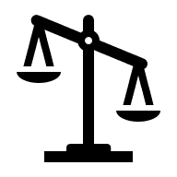

Our domain, facial attributes
Facial Emotion
Recognition
Age group
Classification
Gender
Recognition
Labels (7 classes):
Happy, Surprise, Disgust, Angry, Fear, Sad, Neutral
Labels (9 classes):
0-2, 3-9, 10-19, 30-39, 40-49,
50-59, 60-69, 70+
Labels (2 classes):
Male and Female
Challanges:
Challanges:
Challanges:
Class imbalances
Class imbalances
Different age groups and ethicities
Small datasets
High class intra-variance
Low annotator agreements

Slide 8
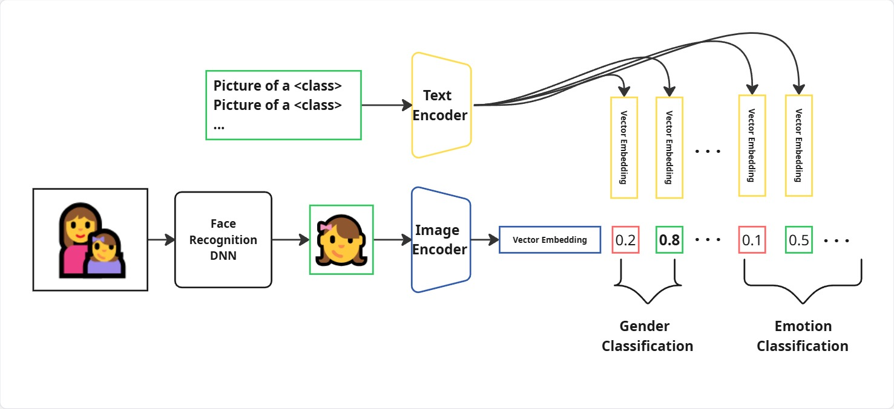
Our Approach, Vision Language Models
Vision language model (VLM) are large neural networks, trained on billion of image-text pairs, that can be use in a zero-shot manner.
We can create a soft-biometric recognition system using a VLM (we choose Perception Encoders).

Slide 9
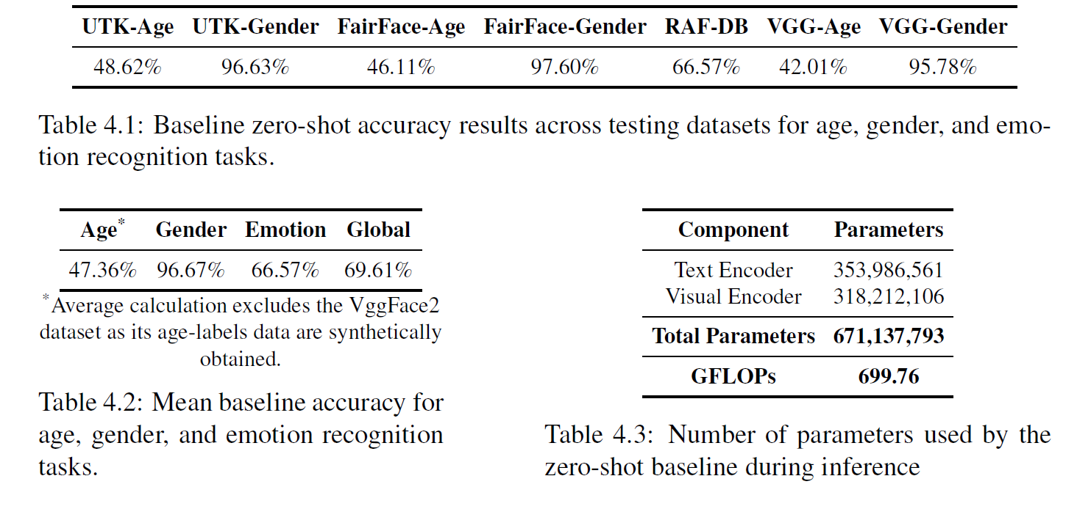








Hard-Prompting, not good enough:
Problems of hard-prompting
Poor accuracy
High memory footprint
High latency
Since visual understanding stems from the vision encoder, we can omit the text encoder and use the image encoder as a foundation vision model, doing so we halve the inference time and memory footprint.

Slide 10
01
02
Introduction
Methodology
03
Results

Slide 11



Datasets used to adapt the pre-trained ViT
Training Set
Test Set
FairFace
~ 97k
Gender & Age
VggFace2
~ 170k
Gender & Age
Lagenda
~ 67k
Gender & Age
UTKFace
~ 24k
Gender & Age
RAF-DB
~ 17k
Emotion & Gender
FairFace & RAF-DB; Test-splits
CelebaHQ
~ 17k
Gender
. Low amount of celebrity data
. Diverse ethinicities rappresented
. High annotator agreements
. Cross-dataset generalization
. Intra task-class imbalance
. Task imbalance
. Missing labels

Slide 12
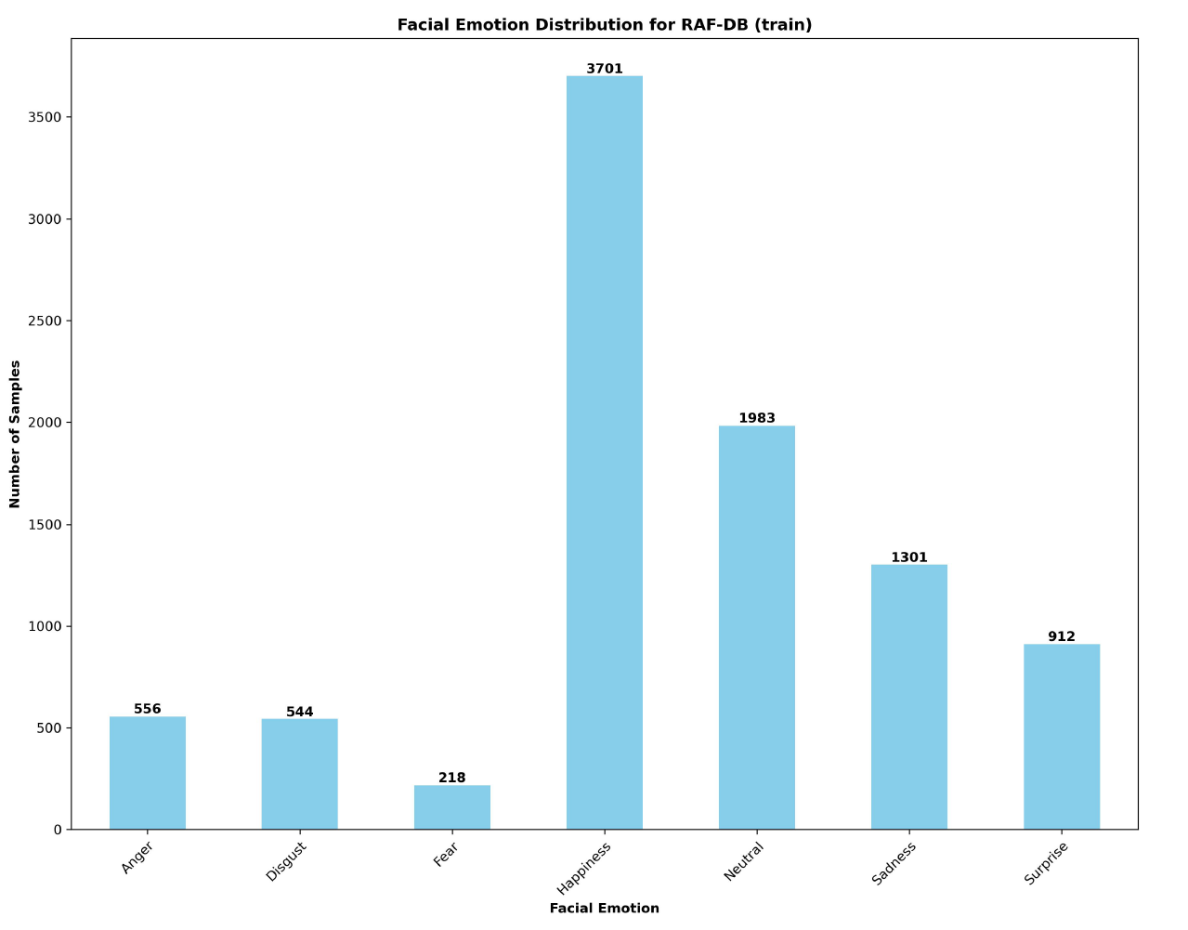

Slide 13
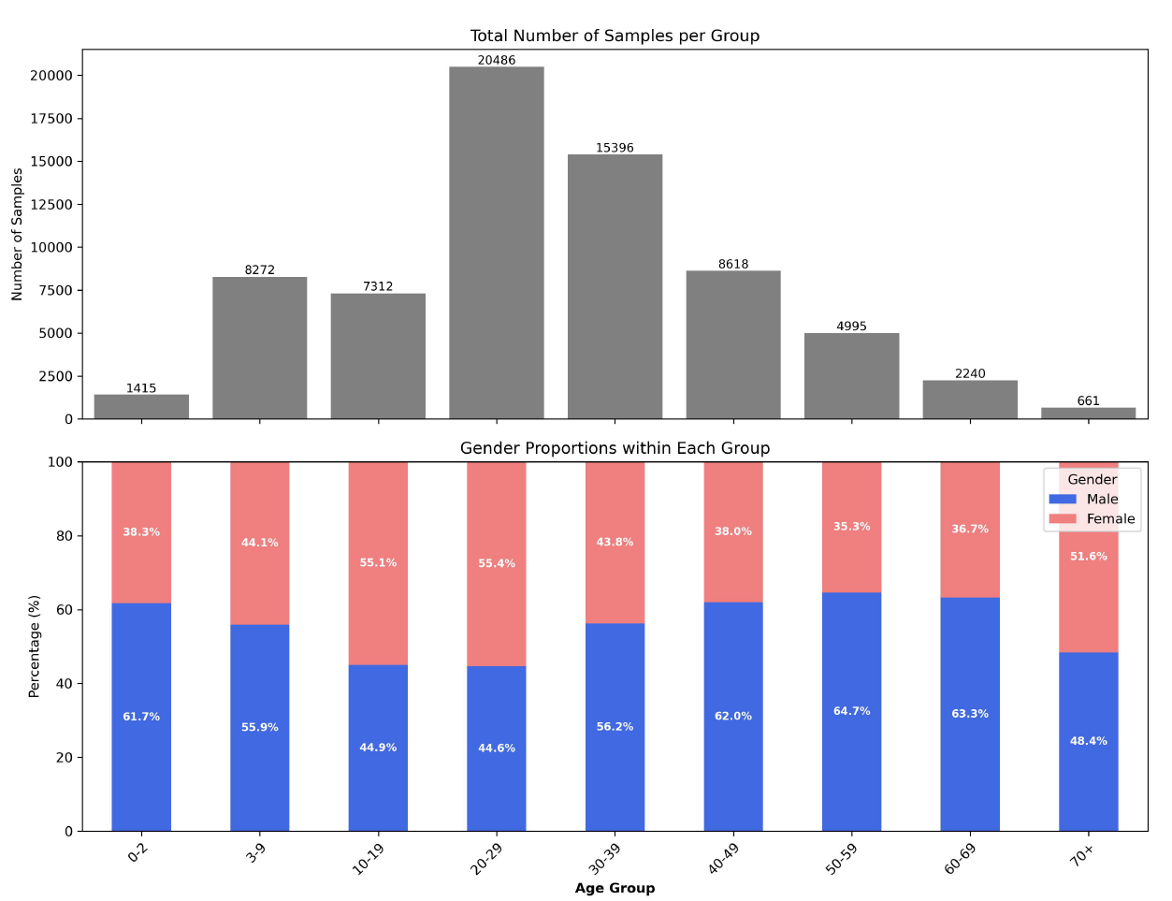

Slide 14
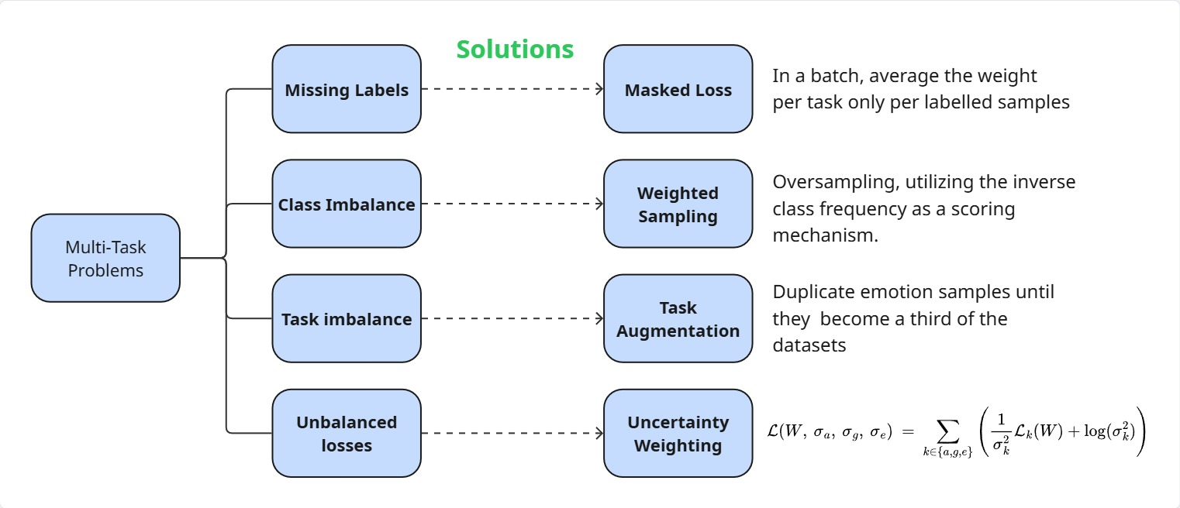
Multi-task learning, problems and solutions

Slide 15
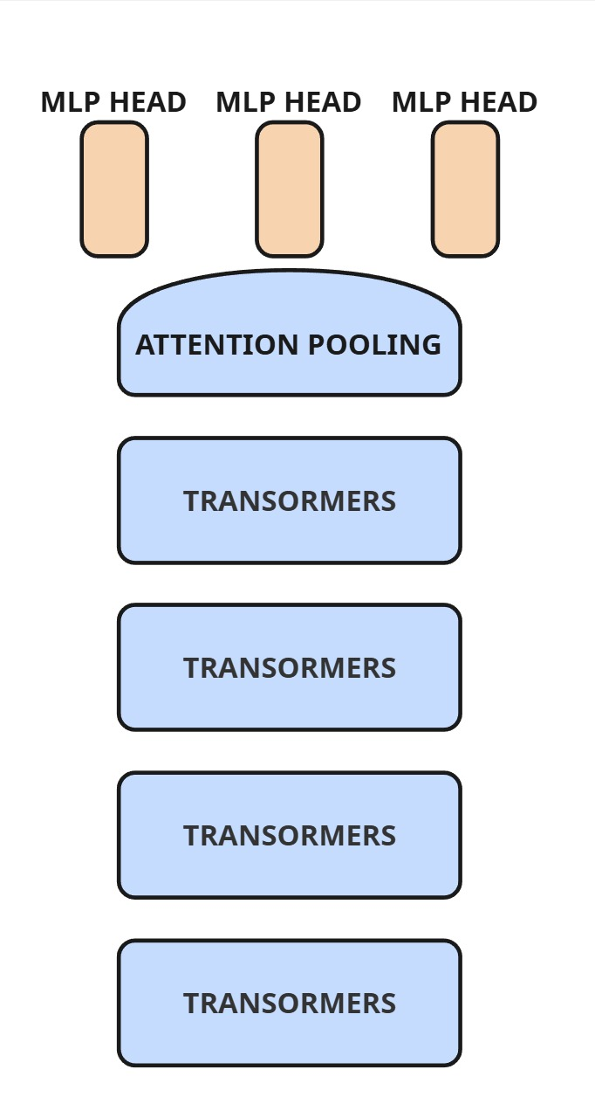
Linear Probing: attaching a MLP classifier per task to the output of the model, to harness the out-of-the box features of the vision transformers. As there can be no benefit to train the classification head simultaneously, as there is no parameter sharing, they are trained sequentially on fully labelled datasets split.
Training: 0.33% of parameters
Trained
Frozen

Slide 16
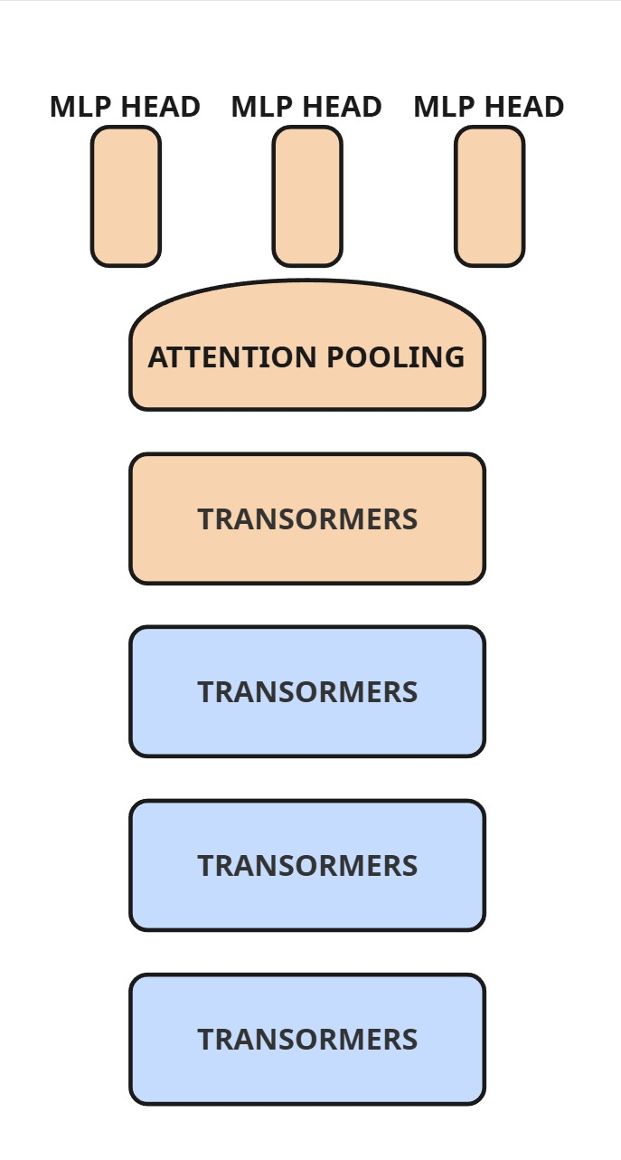
Partial fine-tune: unfreezing the attention pooling layer and last four transformers block of the ViT, using a differential LR strategy (using 1/10 of the LR for transformers blocks)
Training: 20.13% of parameters
Trained
Frozen

Slide 17

Can we go deeper with full fine-tune?
Not really: Not enough VRAM
Use gradient checkpointing and mixed precision? Still not enough.
Use a smaller batch size? Noisy gradients, accentued by the multi-task setting.
Do we want to go deeper? Yes*
Adjusting the early-layer feature representations within the vision encoder may offer significant benefits.
Increase capacity with relatively small dataset, possible overfitting.
*
Full fine-tuning could allow task-specific gradients to destroy the network powerful, generalized knowledge, “Catastrophic forgetting”

Slide 18
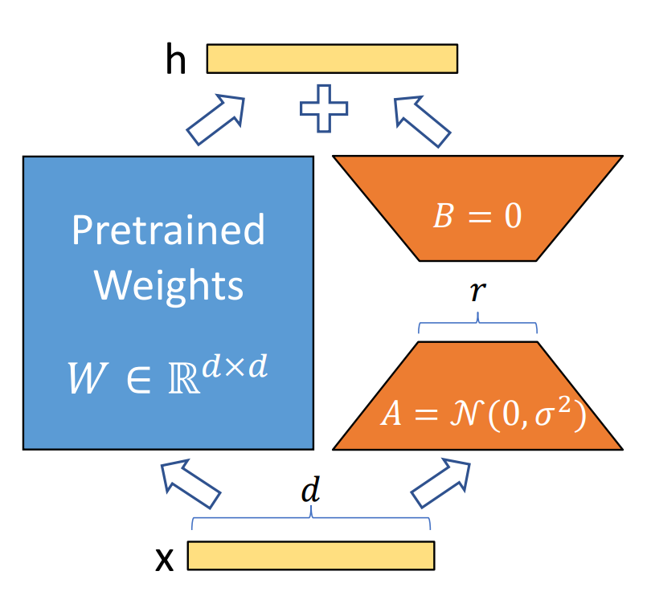
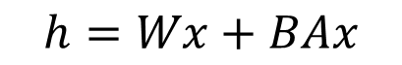
Parameter Efficient Fine-tune with Low Rank Adaptation
Main Idea: the weight updates for large pre-trained model can be effectively represented in a low-dimensional subspace.
$$h=Wx+BAx$$
Benefits of LoRA:
- Small checkpoints
- No added inference latency and memory footprint
- Lower VRAM consumption due to parameter-efficient updates
- Prevents «catastrophic forgetting» by limiting weight update in a low-rank space

Slide 19
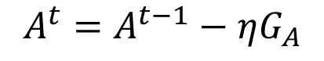
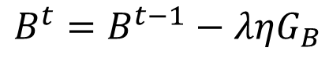
Enhancements for LoRA: LoRA+ & DoRA
Main Idea of LoRA+: we can achieve a better LoRA fine-tune by employing a differtential learning rate strategy for the LoRA matrices.
Training update for LoRA+:
$$B^{t}=B^{t−1}−ληG_{B}$$
$$A^{t}=A^{t−1}−ηG_{A}$$
In our implementation, we set $λ= 6$

Slide 20
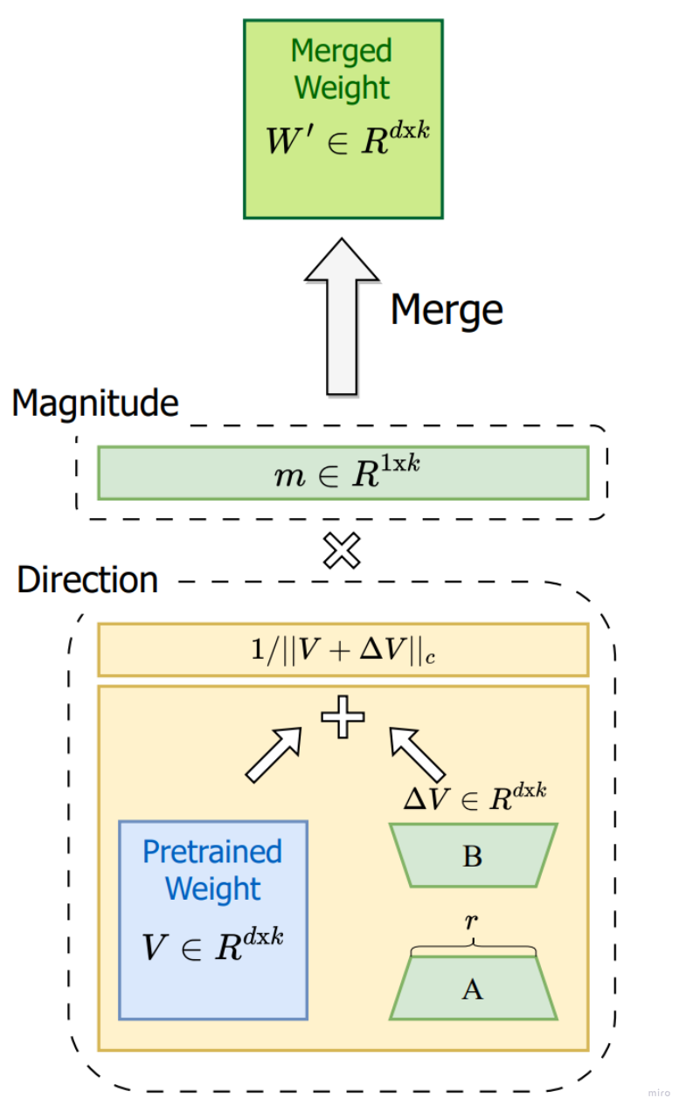
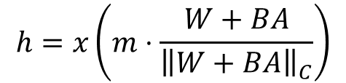
Enhancements for LoRA: LoRA+ & DoRA
Main Idea: enhance the weight update by seperately training the direction and magnitude of the update.
$$h=x\left(m⋅\frac{W+BA}{{\left\|W+BA\right\|}_{C}}\right)$$
Benefits of DoRA:
- Same benefits of LoRA
- Increased learning capacity

Slide 21
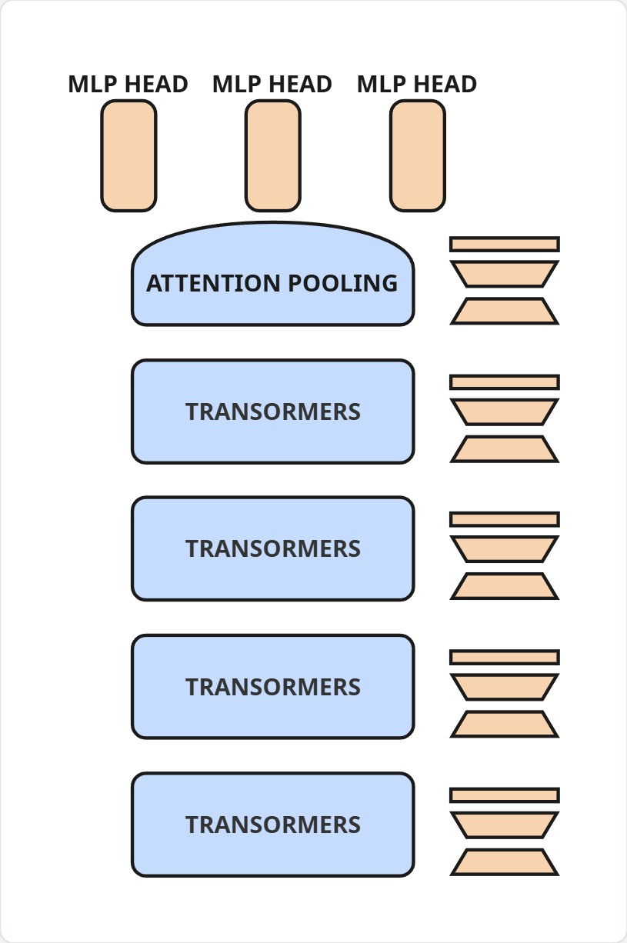
Contesto
DoRA & LoRA+ : adding DoRA adapters with rank=64 to each linear layer of the Vision Transformer and using a learning rate x6 to train the B matrices of the adapters.
Training: 8.47% of parameters (less than half of FT4)
Trained
Frozen
Notes:
Nel mondo di oggi, l’interazione uomo-macchina sono se

Slide 22
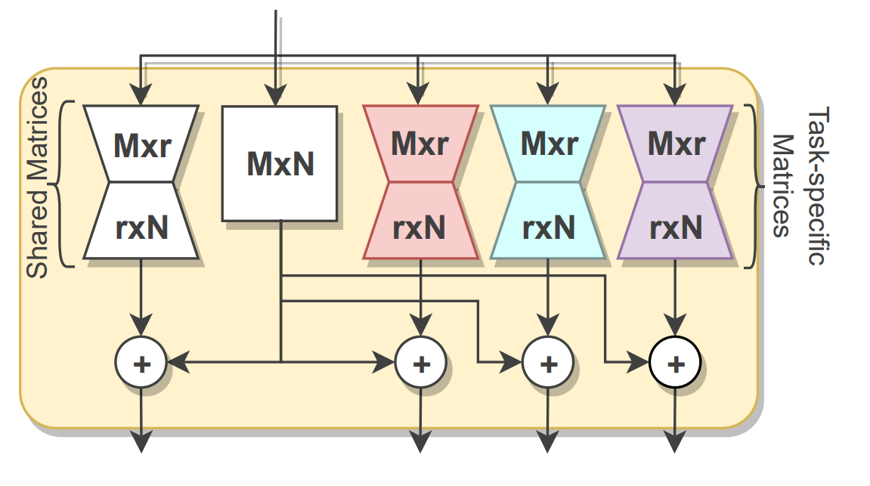
PEFT & Multi-task: MTLoRA
Main Idea: disentangle the parameter space trough Task-Specific LoRA matrices
Benefit:
- Train specialized parameters for a task, and use them to create task-specifics feature-maps
Deficit:
- The task specific LoRA matrices cannot be merged, small increase in memory footprint and inference latency

Slide 23
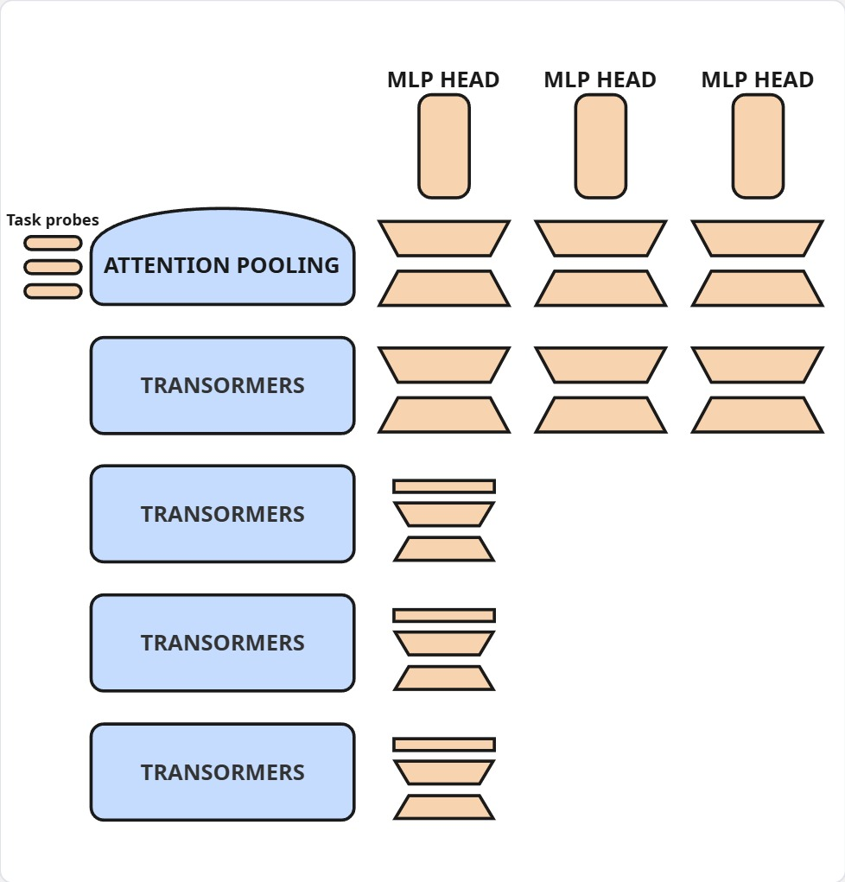
Contesto
MTLoRA: TS-LoRA (r=64) applied to last transformer block and attention pooling layers. TA-DoRA using the same setup describe earlier.
Training: 10.38% of parameters
Trained
Frozen

Slide 24
01
02
Introduction
Methodology
03
Results

Slide 25
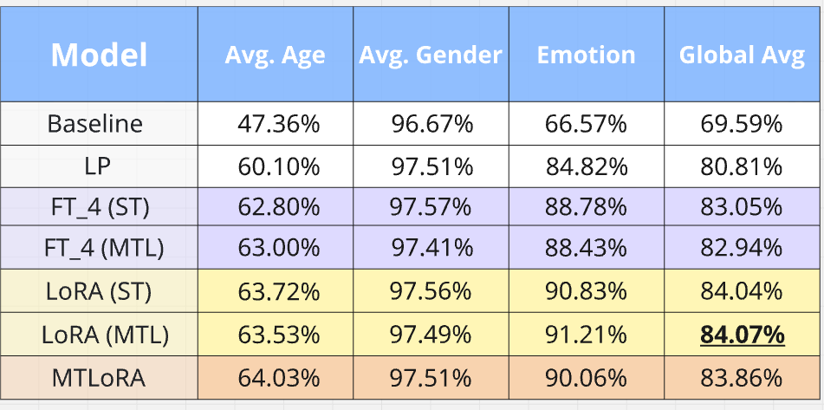
Multi-task Vs. Single-task
Multi-task approach was successful in preventing negative-transfer, all of our multi-task model achieve perfomance parity compared to their single-task equivalent
-0.11%
+0.03%
-0.18%

Slide 26
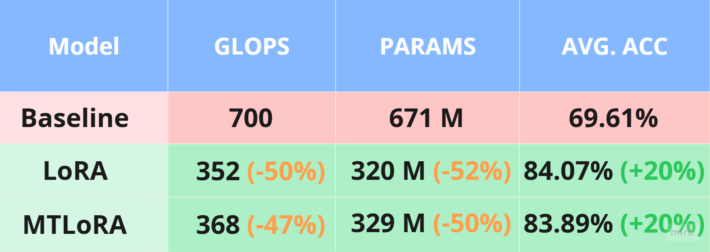
Efficiency Comparison

Slide 27
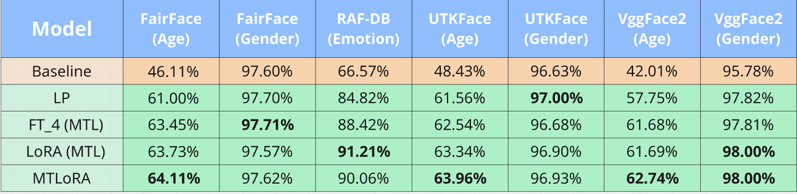
Multi-task model detailed results

Slide 28
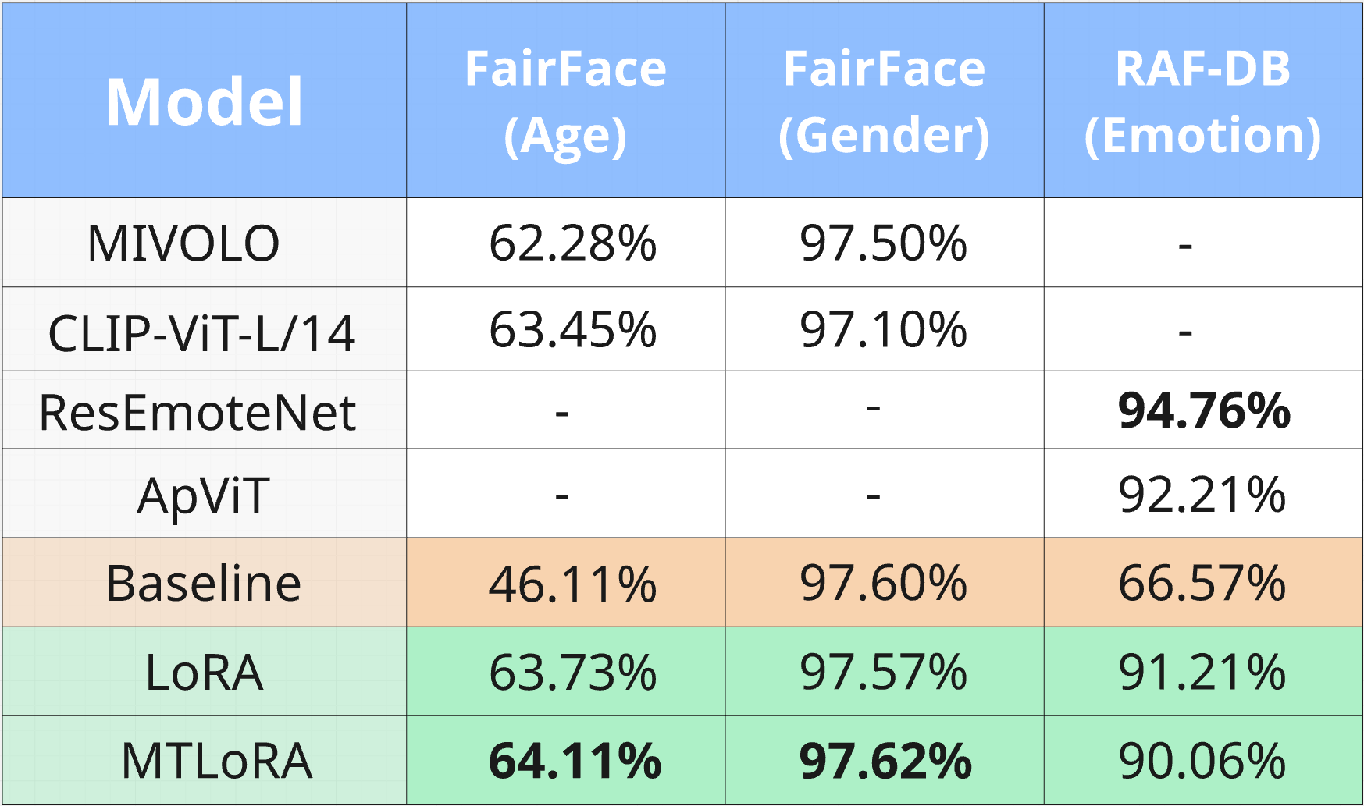
Comparison with the state of the art

Slide 29
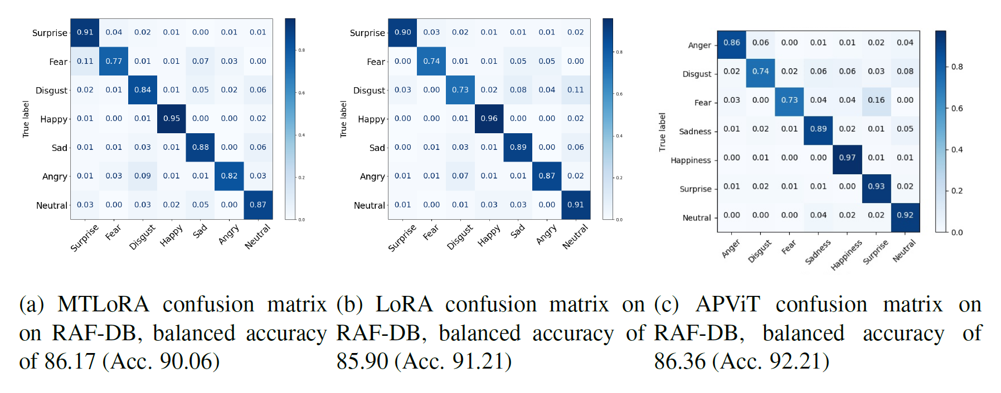



-0.19%
-0.46%

Slide 30
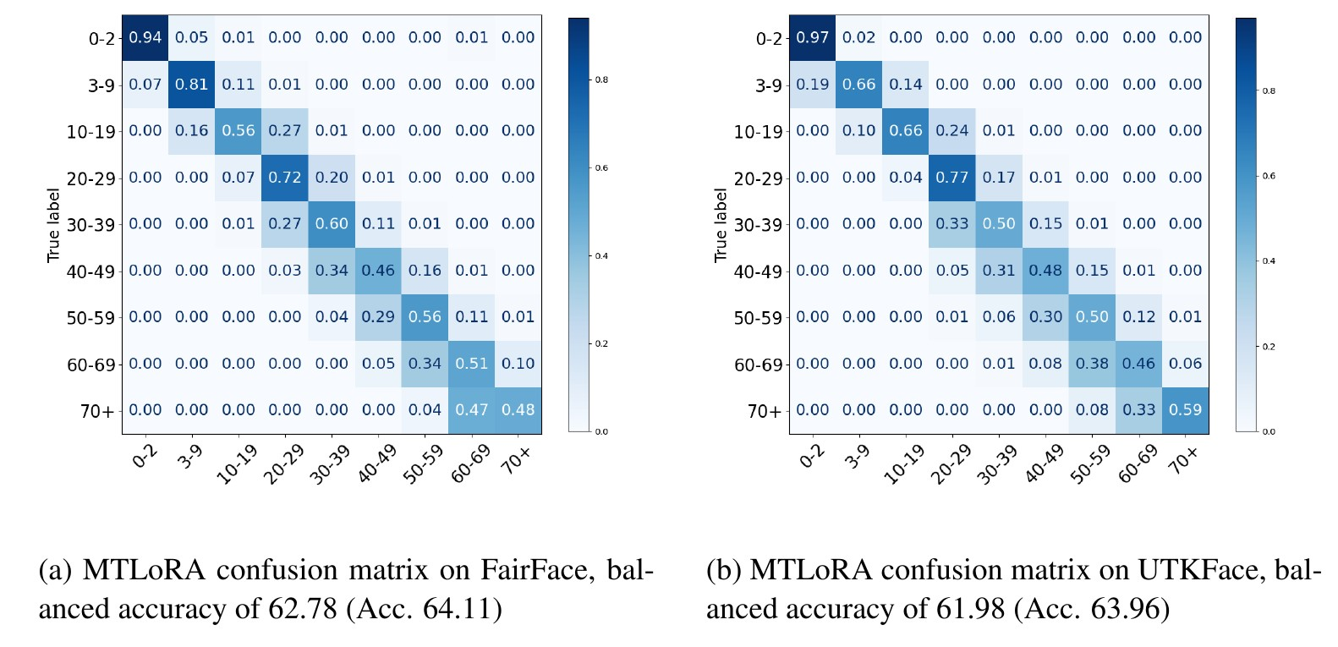



Slide 31
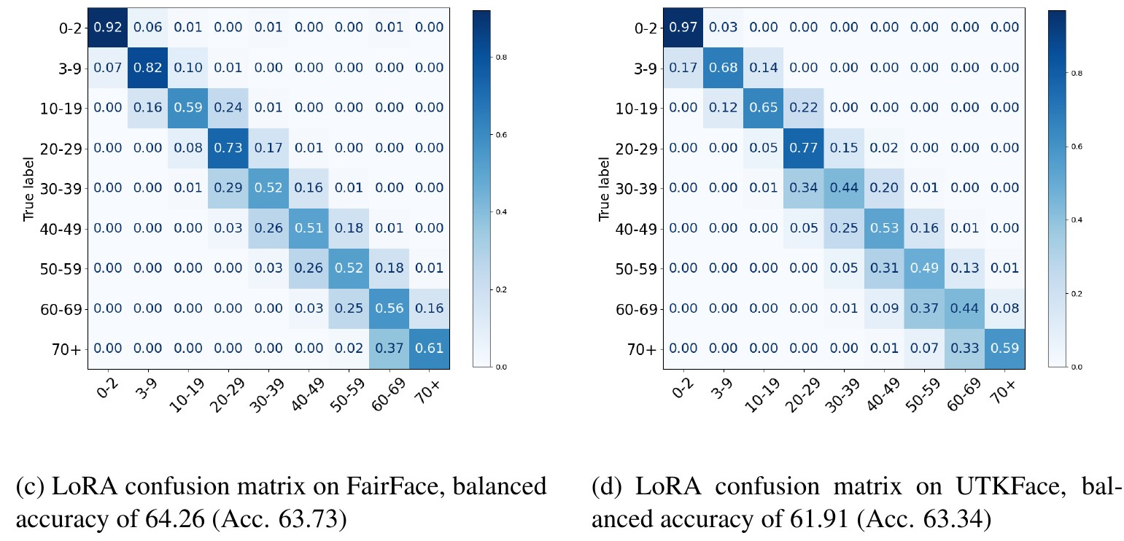



Slide 32
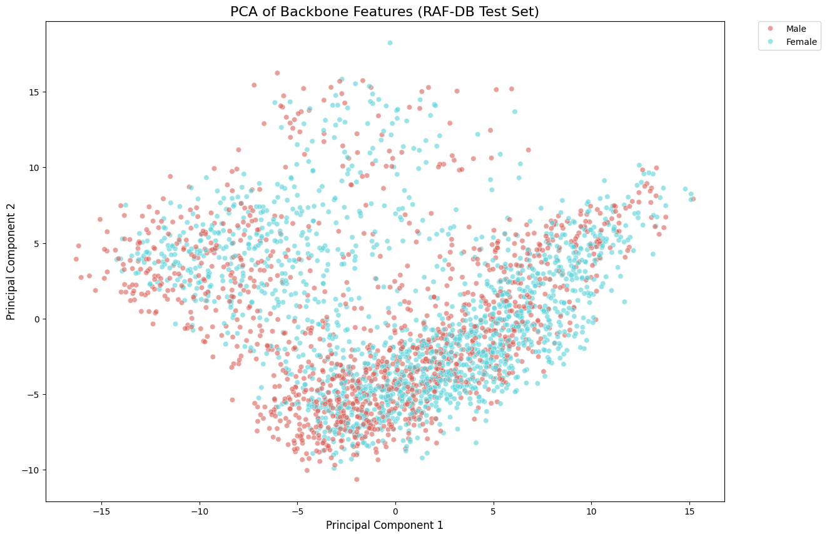
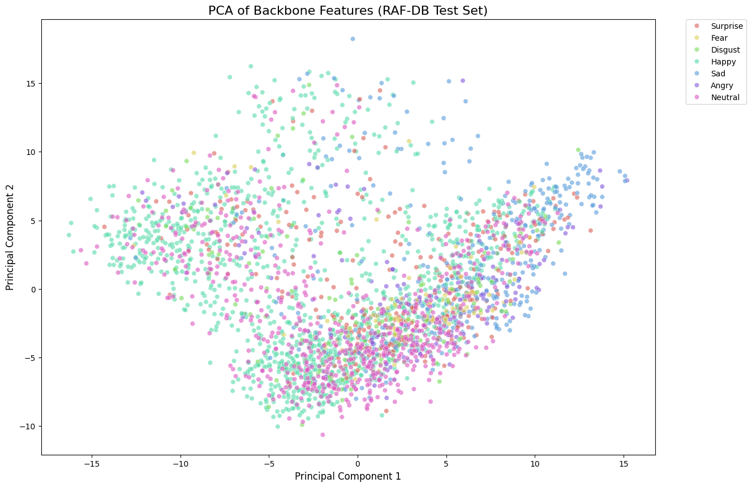
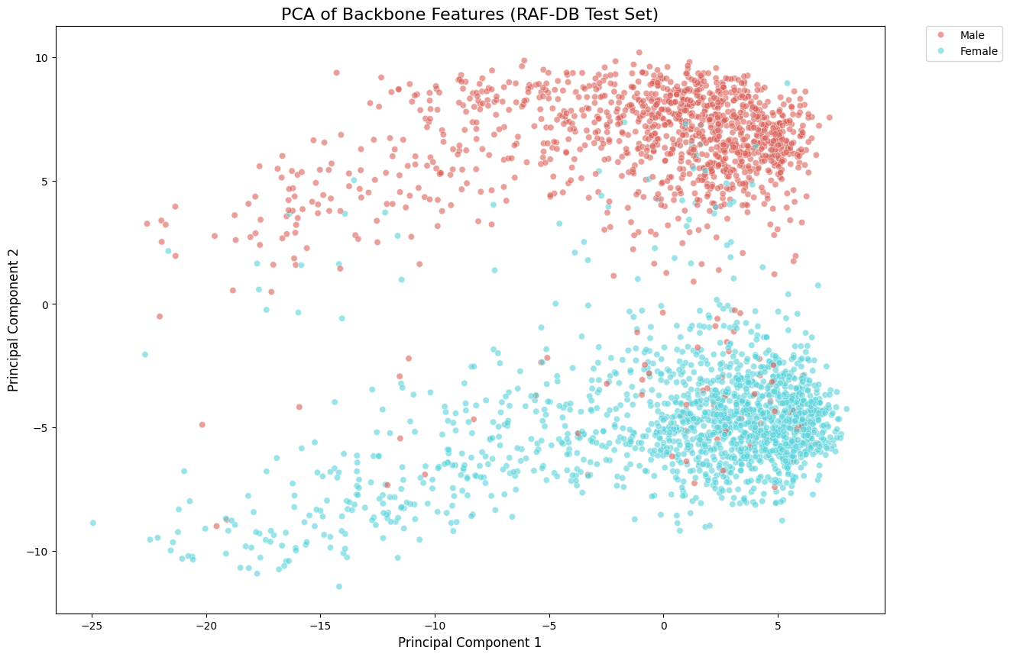
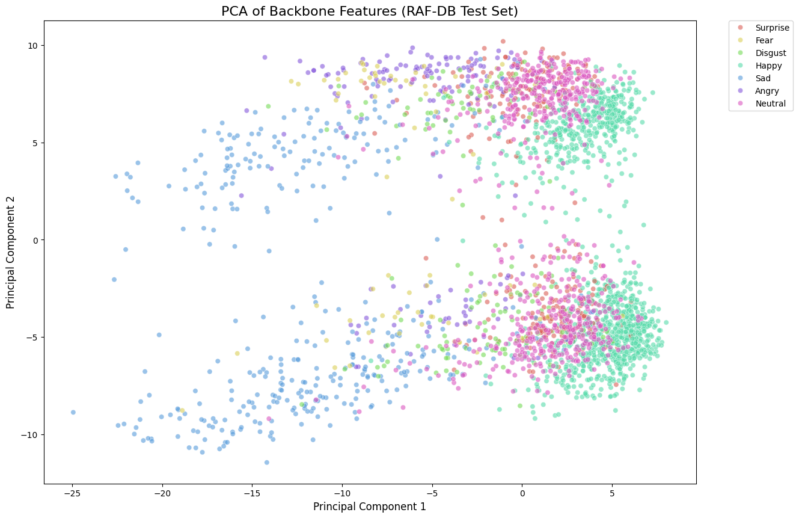

Slide 33
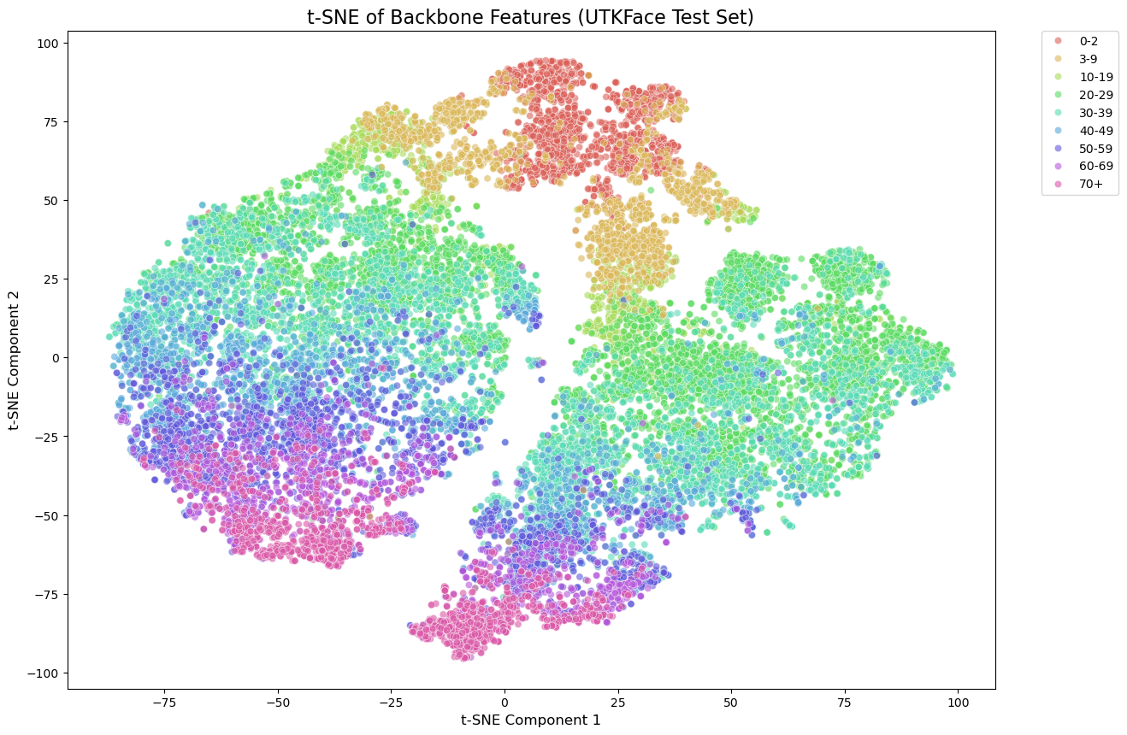
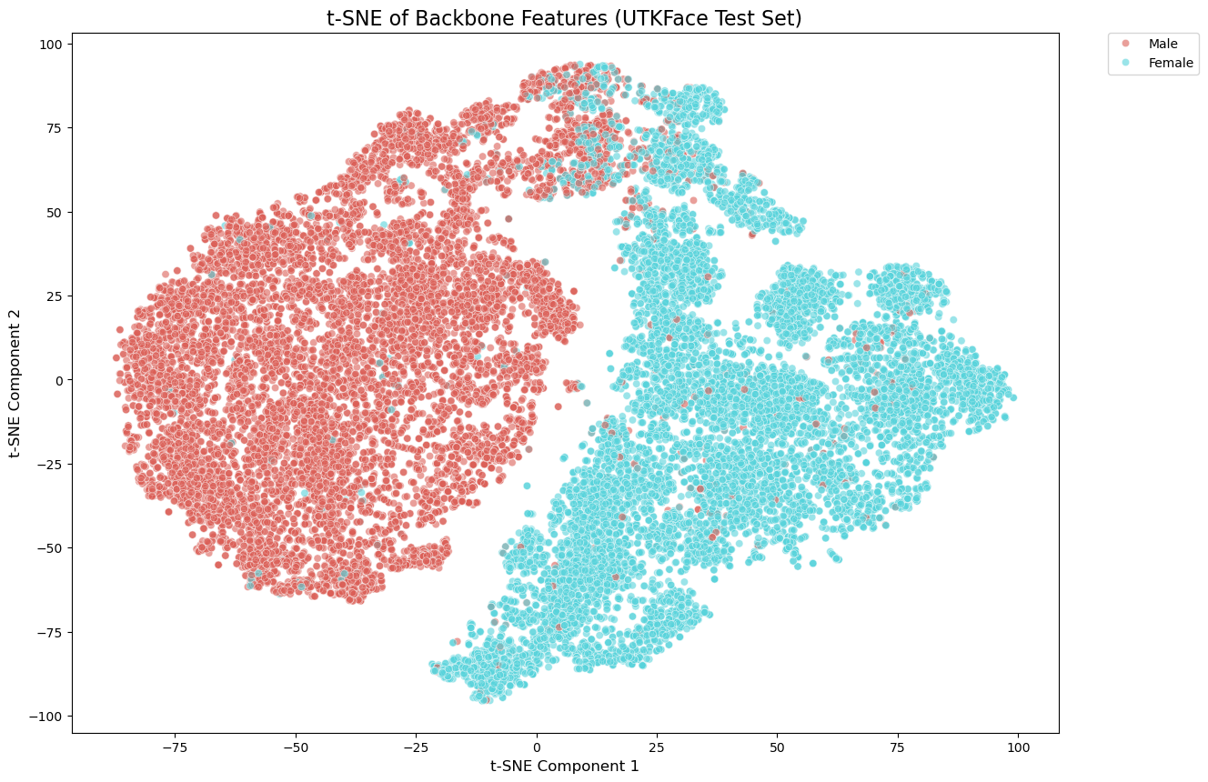
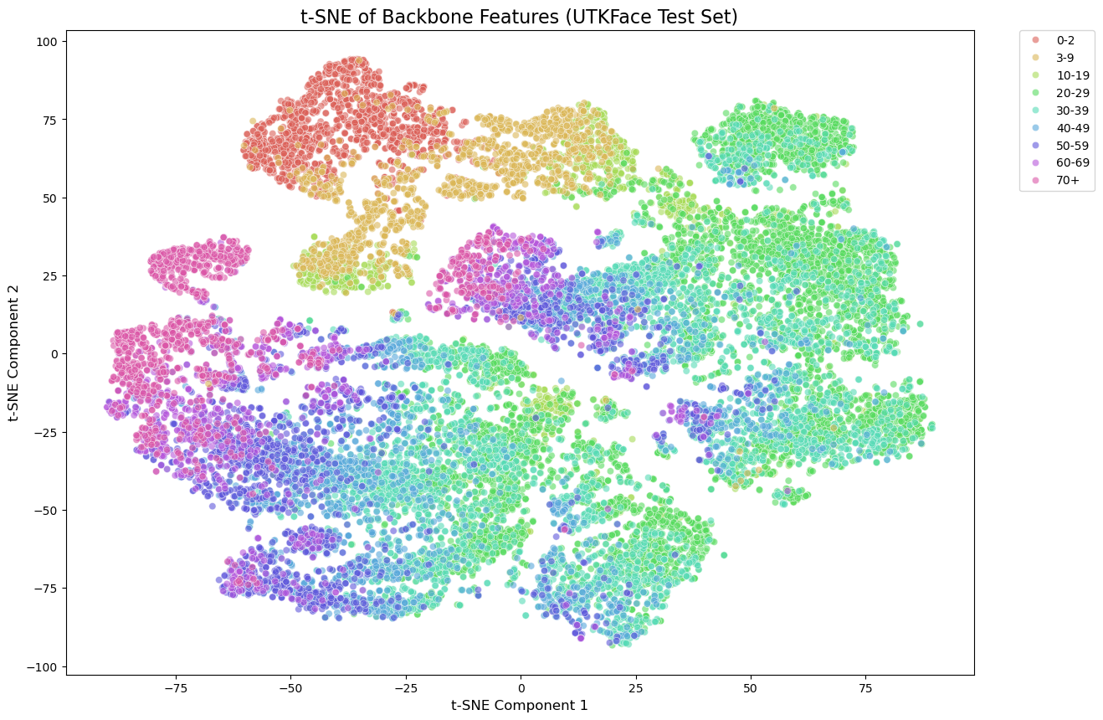
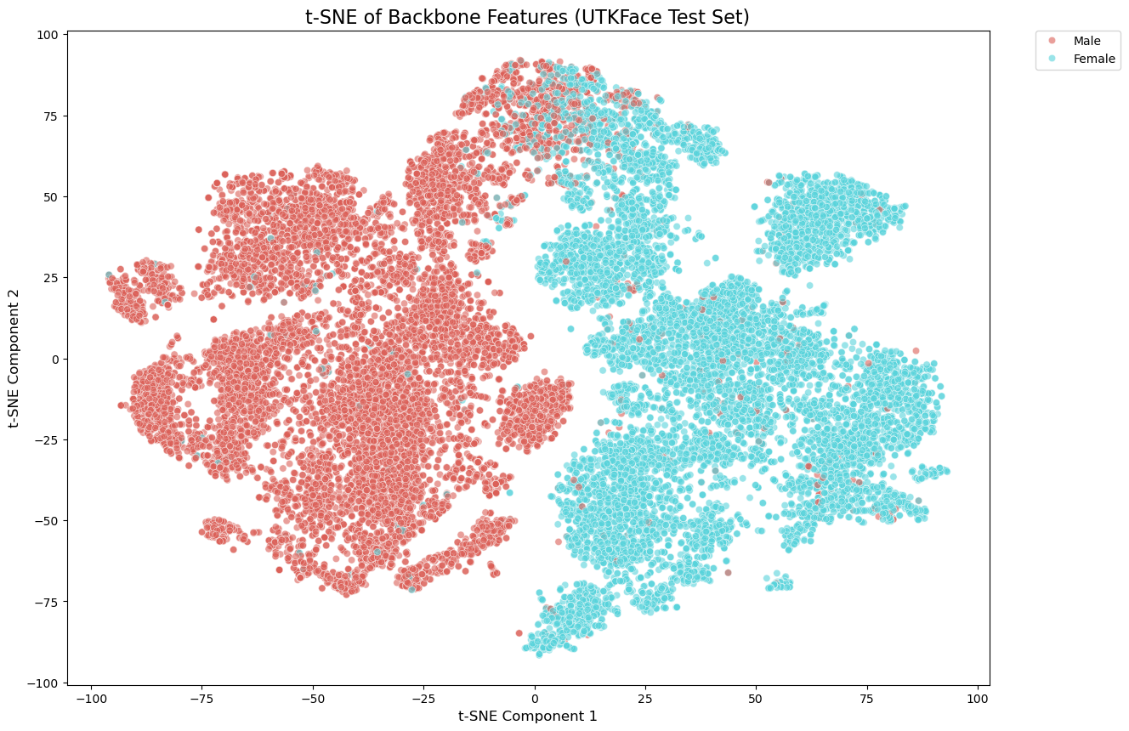

Slide 34
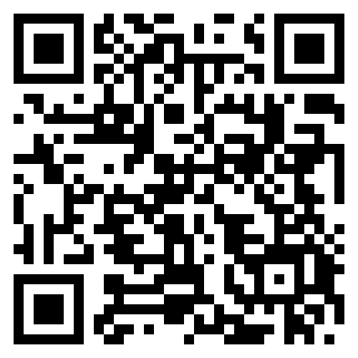
Dimostratore
https://huggingface.co/spaces/Antuke/FaR-FT-PE

